Slide 1

CPE 403 / ECG 603 Final Project
Stryder Loveday
Morgan Kiger

Slide 2
Goal
Main Goal
Design and implement a star-topology wireless sensor network for remote data monitoring.
Objectives
Create a series of Sensor Nodes using CC1350 LaunchPad devices to gather and transmit data from remote locations using both integrated and external sensors.
Develop a system to host and display gathered data using the BeagleBone Black platform.
Integrate a CoProcessor unit into the BeagleBone Black system allowing interfacing with the wireless sensor network using a CC1350 LaunchPad.

Slide 3
Outcome - Accomplishments
Outcome
We connected the coprocessor CC1350 LaunchPad with the BeagleBone Black (BBB) and ran the TI 15.4 stack linux sdk prebuilt files to connect the two devices through a UART interface.
The BBB device collected the data passed through UART and displayed it on a locally-hosted web server.
The web page displayed the data of the three sensor nodes and showed the network diagram of the established star topology.
Displayed data included temperature (both integrated and external), humidity, and lux.
Short-term - This project showed the basic idea of internet of things and taught us how to transfer data over I2C as well as a brief introduction to using RF drivers.
Long-term - We are beginning to explore additional paths this project can take with regards to further integration including historical data logging, modular sensor integration for ease of additional deployment, and bi-directional control systems to allow for both automated and manual control of systems in addition to data gathering.

Slide 4
Components Used in Design
Four CC1350s, three acting as sensor nodes and one acting as a coprocessor for the BBB collector.
BeagleBone Black used to display the data on a local web page
TSL2591 lux sensor
BME280 temperature, pressure (unused), humidity sensor
Internal temperature sensor for the CC1350s without external temperature sensors.

Slide 5
Tools used in Design
Code Composer Studio
VirtualBox (linux distro)
BeagleBone Black
CC1350 Launchpad
TI SmartRF

Slide 6
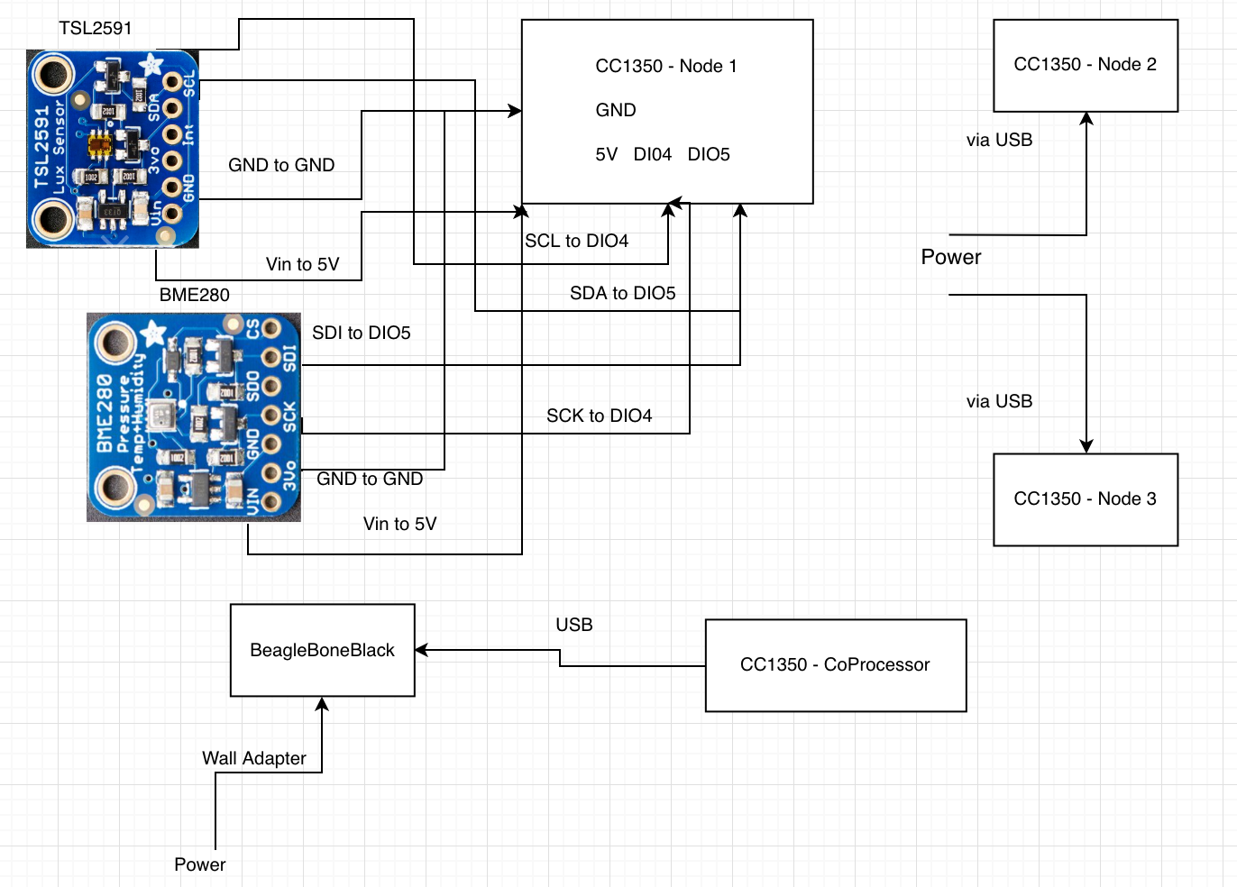
Schematics

Slide 7
Prerequisites used in Design
Prerequisites
ti154stack_linux_x64_2_07_00_16.run, used x64 linux distro to extract the file. copied the extracted files over using ‘scp’ to the BBB
changing collector.cfg file within BBB to match config settings for sensor nodes
sample code from the TI sensor/collector project as a starting point
sample code provided by Dr. Venki as a starting point
Commands to install prerequisites
$ sudo ./setup.sh (created my own shell script with all the installs needed taken from all the BBB labs)
$ cd sdk_installers/ti154stack_linux_x64_2_07_00_16/
$ sudo ./build_all.sh

Slide 8
Implementation Details
Steps used in design:
In order to implement the coprocessor and the BeagleBone Black
we had to flash the coprocessor with the co-processor hex file using SmartRF
install the ti 15.4 stack linux sdk to the BeagleBone Black
In order to get our three sensor nodes working
code the BME280 sensor to transfer temperature, humidity data
code the CC1350 to transfer data from the internal temperature sensor
code the TSL2591 sensor to transfer lux data
In order to link the sensor nodes with the coprocessor
we had to update the config.h file within the sensor project in CCS to the desired channel and how frequently we wanted it to transfer over data
for the co-processor there was a collector.cfg housed on the BBB that held the config settings for the co-processor, we had to make sure the desired channel matched the sensor config.h file
Finally we ran the ./run.sh file within the ti 15.4 stack linux sdk to launch the local web page that displayed the data of the sensor nodes

Slide 9
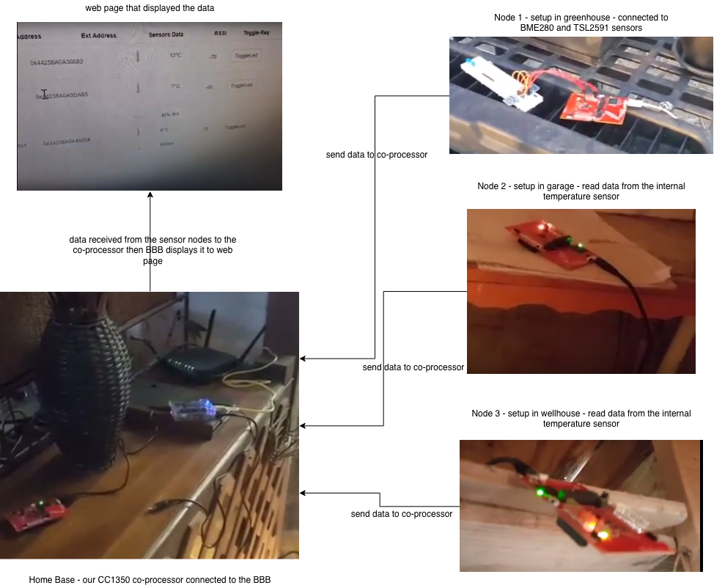
Actual project set-up

Slide 10
Demo
Final Project-Full Playlist: https://www.youtube.com/playlist?list=PL4oTyvRrubXcS0LoUD7CAUeTa39r0GmdZ Final Project-Node1 - Greenhouse: https://youtu.be/10ZlS5j3oLw Final Project-Node2 - Garage: https://youtu.be/K6hS5C7jwtQ Final Project-Node3 - Wellhouse: https://youtu.be/zHoJbi2XBzA Final Project-Base Station: https://youtu.be/Yt7nfbNYGBM

Slide 11
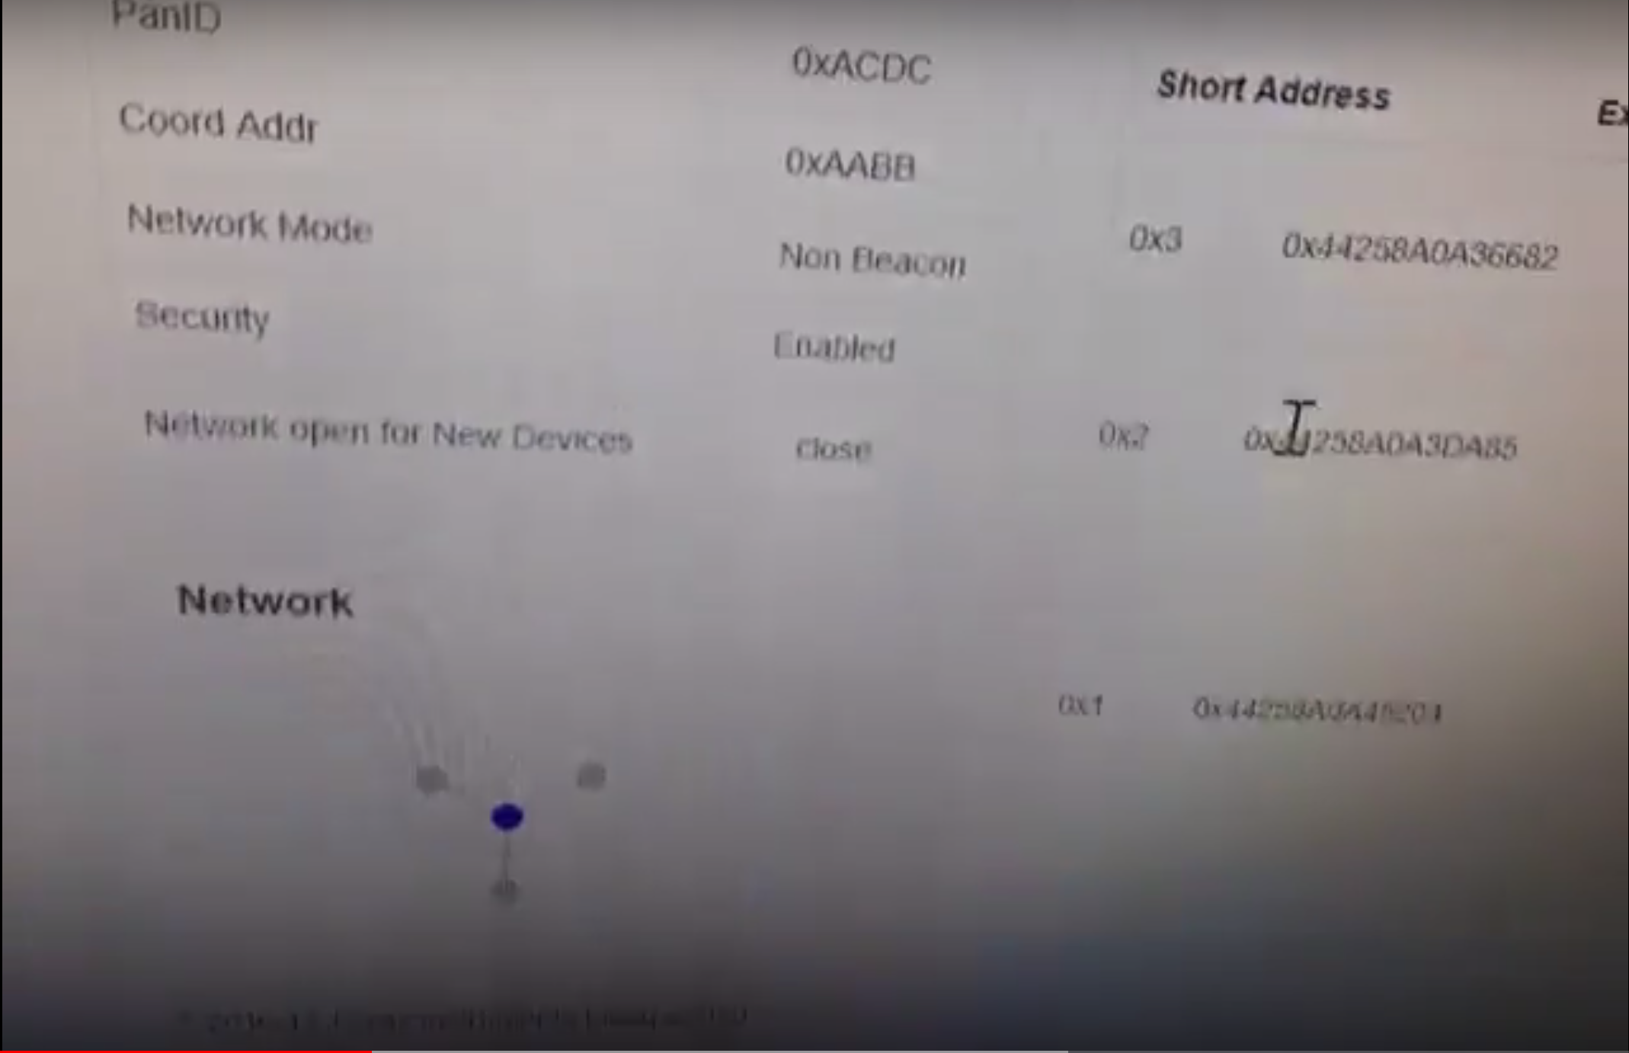
Results
Fig 1: you can see the network connection on the bottom left and the sensor node address on the right

Slide 12
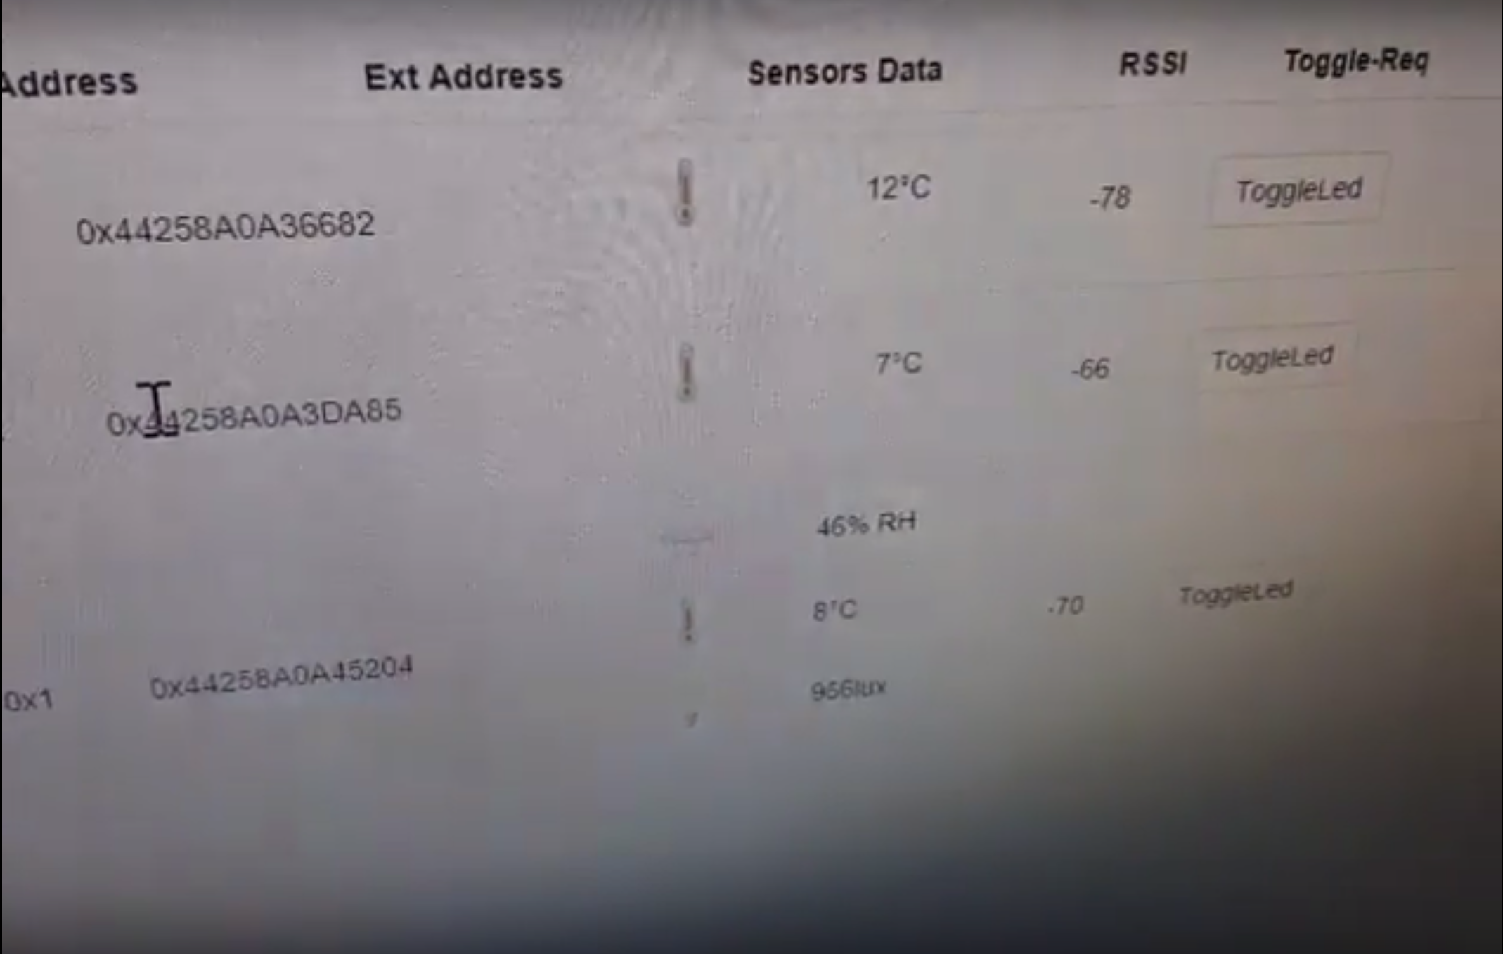
Results
Fig 2: picture of the data displayed on the local web page taken from the sensor nodes

Slide 13
Conclusions
Wireless Sensor Network (Star-Topology) implemented:
3x Sensor Nodes (CC1350)
1x Collection/Coprocessor Node (CC1350)
1x Data Visualization Node (BBB)
Data was gathered from remote sites:
Greenhouse
Temperature, Humidity, Lux
Garage
Temperature
Wellhouse
Temperature
Further improvements to be implemented:
Development of framework to expand data-sending functionality.
Dynamic data type creation to allow additional flexibility.
Further modularization of sensor code design.
Allow “plug-and-play” functionality for ease of node and sensor creation.
Expand on polling functionality to allow additional control actions.
Automatic/Manual dynamic control of remote devices based on sensor data and additional logic implemented at base station.

Slide 14
Reference
Instruments, T. (2018). Example Applications — TI 15.4-Stack 0 documentation. [online] Dev.ti.com. Available at: http://dev.ti.com/tirex/content/simplelink_cc13x0_sdk_1_30_00_06/docs/ti154stack/ti154stack-sdg/ti154stack-sdg/Example%20Applications.html#linux-collector-and-gateway-application [Accessed 12 Dec. 2018].
abrain (2018). Sub-1 GHz Sensor to Cloud IoT Gateway - Review. [online] Element 14. Available at: https://www.element14.com/community/roadTestReviews/2590/l/sub-1-ghz-sensor-to-cloud-iot-gateway-review [Accessed 12 Dec. 2018].

